Slide 1
Improved KNN through Hyperplane Division and Instance Removal
Kaushik Siruvuri and Liam Baird

Slide 2
Issues with the Original KNN Algorithm
KNN is a lazy learner, and does not build a model. Instead, it uses all data points when testing.
This approach is difficult to scale up to higher instance and feature counts, as time and space complexity increase exponentially.
To remedy this, we looked into methods of reducing the instance count that KNN runs on, through random aggregation and hyperplane division.

Slide 3
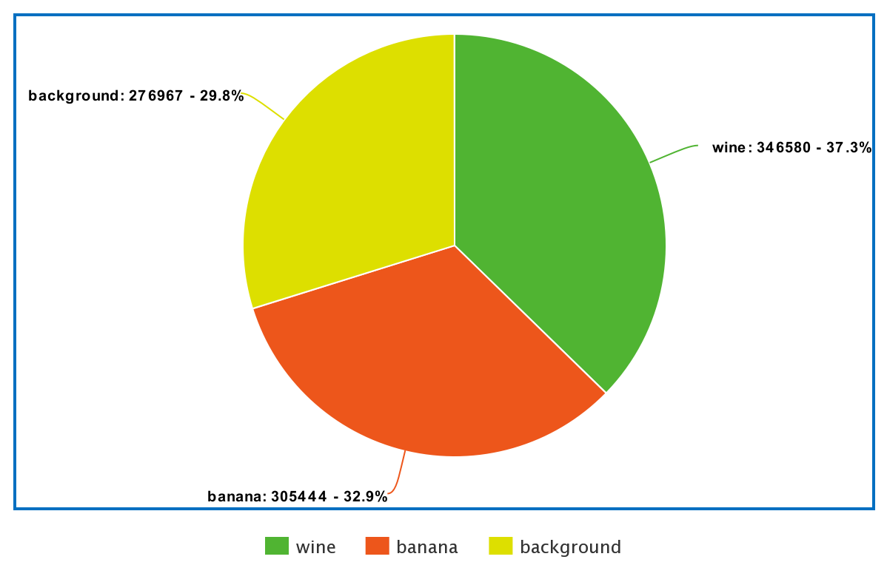
Dataset
We looked for a dataset with a high instance count to more easily compare run times on.
We ended up using a dataset from the UCI Machine Learning Repository
Data from a gas sensor array in proximity wine, a banana, or nothing
928991 instances and 10 dimensions
eight metal oxide sensors measuring gas concentration, one temperature sensor, and one humidity sensor
id | time | R1 | R2 | R3 | R4 | R5 | R6 | R7 | R8 | Temp. | Humidity
0 | -0.99975 | 12.8621 | 10.3683 | 10.4383 | 11.6699 | 13.4931 | 13.3423 | 8.04169 | 8.73901 | 26.2257 | 59.0528

Slide 4
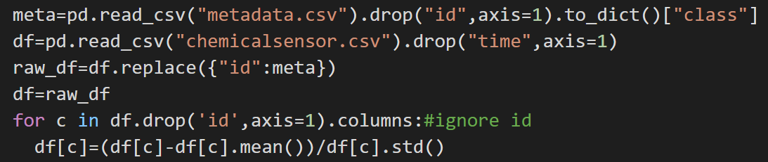
Dataset P. 2
The ID’s of the dataset corresponded to different class labels, which were stored in a separate header file. We had to replace these accordingly using a dictionary.

Slide 5
Methods

Slide 6
KNN
K Nearest Neighbors (KNN) is a supervised machine learning algorithm that sorts data based on distance. KNN is a lazy learner, meaning it only iterates through training data when a testing point is given. A typical KNN algorithm follows these steps:
Given training data set S and testing point I
for every training data point S_{i} in S:
Calculate distance from S_{i} to I
Create set A containing k smallest calculated distances
Return the majority classification of set A
O(n*m) time complexity

Slide 7
Spatial Division
Spatial division can be used to reduce data size. By organizing data into subsets based on the spatial location of the data, comparisons can be made easier and more efficient. In simple terms, data far away from a test point will not be used, as it would likely not help the model. Our proposed spatial division method is random hyperplane division.

Slide 8
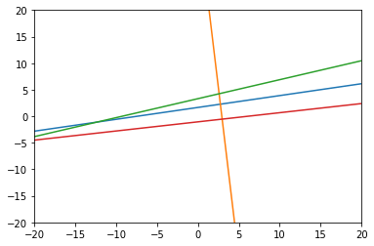
Hyperplanes
Hyperplanes are geometrical objects that can exist in any dimension.
They are categorized as always having a dimensionality one less than the space they exist in.
C + ΣA_{i}X_{i} = 0
C is a constant, A_{i} is a coefficient of a variable, and X_{i} is a distinct variable that characterizes the space.
By nature, each hyperplane splits a space into two regions. Combining hyperplanes would result in multiple regions of space.
4 2D Hyperplanes splitting space into 11 regions

Slide 9
Preprocessing
The dataset is divided into more regions when the “origin” of hyperplane division is closer to the centroid of the points. This makes hyperplane division easier as we do not have to offset the planes.
Dataset
Z-Score Normalization
Aggregation
Dataset with assigned region numbers
Normalized Dataset
Hyperplane Generator

Slide 10
Hyperplane Generation
For every dimension
Random θ Values from 0 to 2𝛑
tangent
Cartesian Coefficients
A_{i}
Offset Value between 0 to 1 standard deviations
C
C+ΣA_{i}X_{i}=0
Hyperplane equation
Generate log(n) hyperplanes, where n is the length of the dataset
We use natural log

Slide 11
Hyperplane Assignment
Find a list of booleans for every training point that correspond to whether the point is above or below a given hyperplane
Convert boolean list to binary number
List of Hyperplanes
Region Assignment
Optimized Equivalent
R=Σ f(H_{i},P)ᐧ2^{i}
def test_hyperplanes(point,hyperplanes):
v=0
for hyperplane in hyperplanes:
v+=f(hyperplane,point)# defined to the left
v<<=1
return v>>1
f(H,P)= 0 if C+ΣA_{i}X_{i}<0
f(H,P)= 1 if C+ΣA_{i}X_{i}≥0

Slide 12
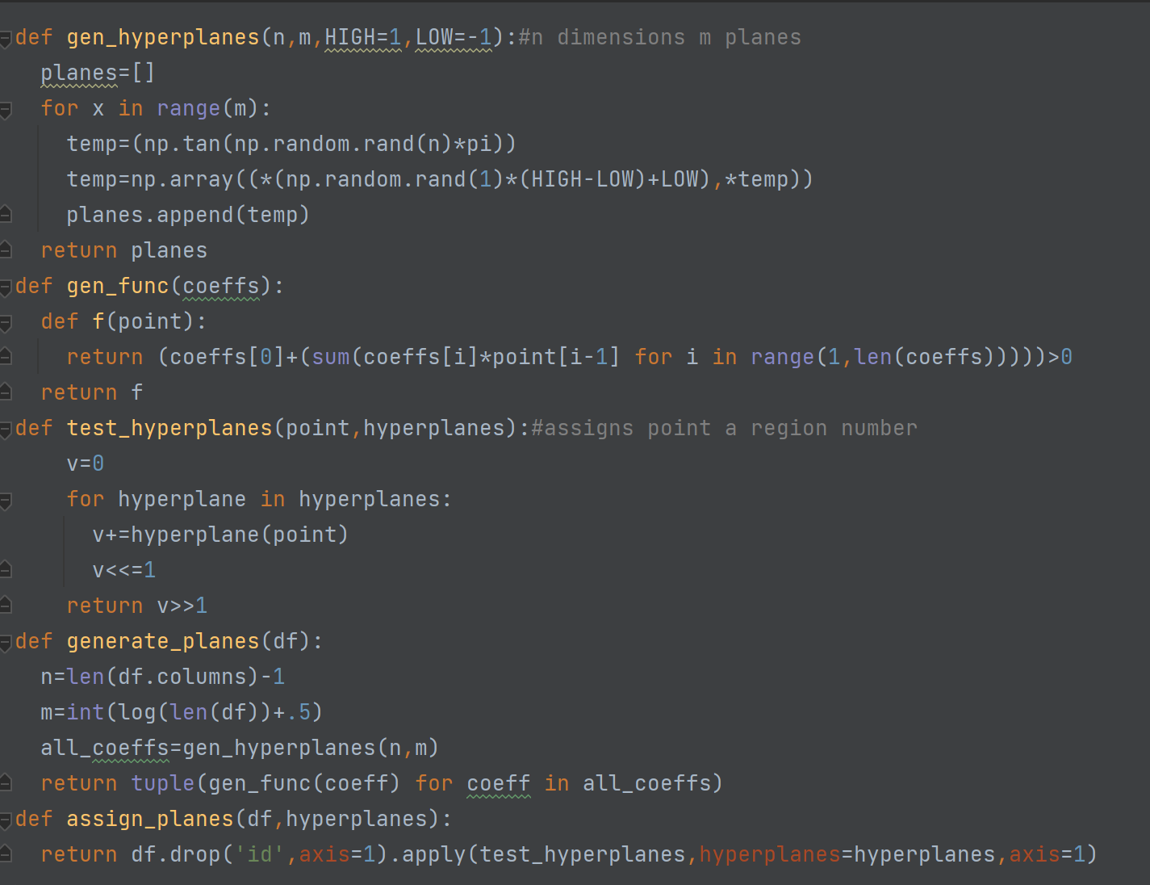

Slide 13
Aggregation Algorithms

Slide 14
K-Means
We attempted using K-Means as a way to aggregate data, with the intention of running a high cluster count before KNN in an effort to reduce data points.
We found that it took too long to run on a dataset of this size, and abandoned our attempt. (It would be more time-efficient to just run KNN).

Slide 15
Random Mutation Hill Climbing
Aggregation Process to remove data points based on randomness and evolution
Replace a random point in S with a random training point
Evaluate Accuracy - If greater than before, do nothing, else revert
Create random subset of training data S of size M
Repeat N times
Return New Dataset
M and N are both chosen by the user.

Slide 16
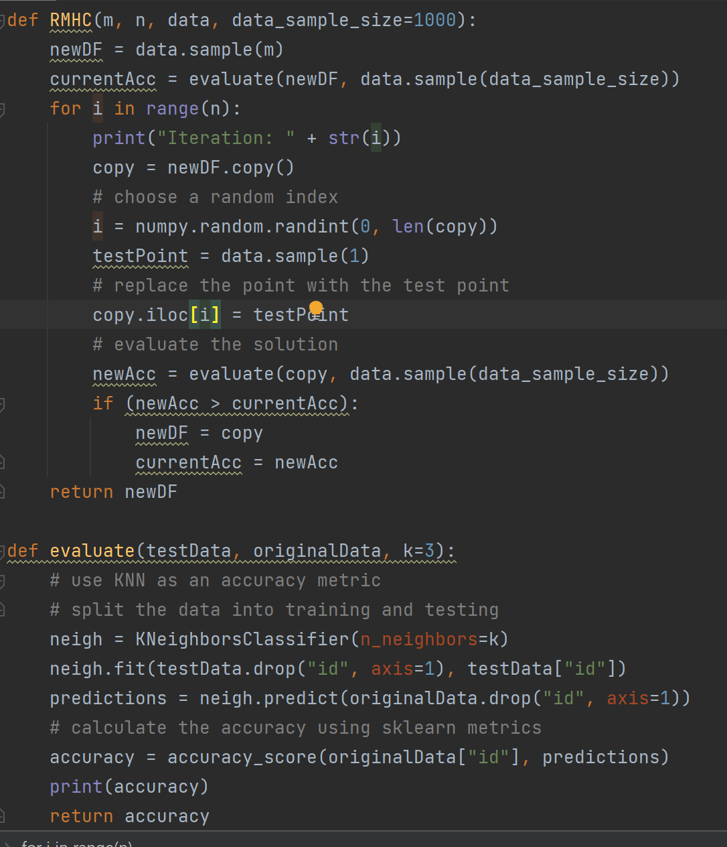
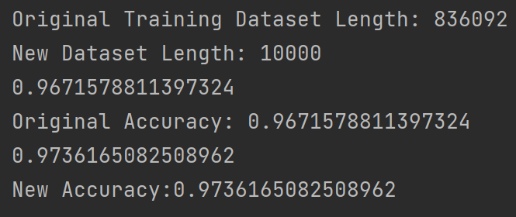
Accuracy and Implementation

Slide 17
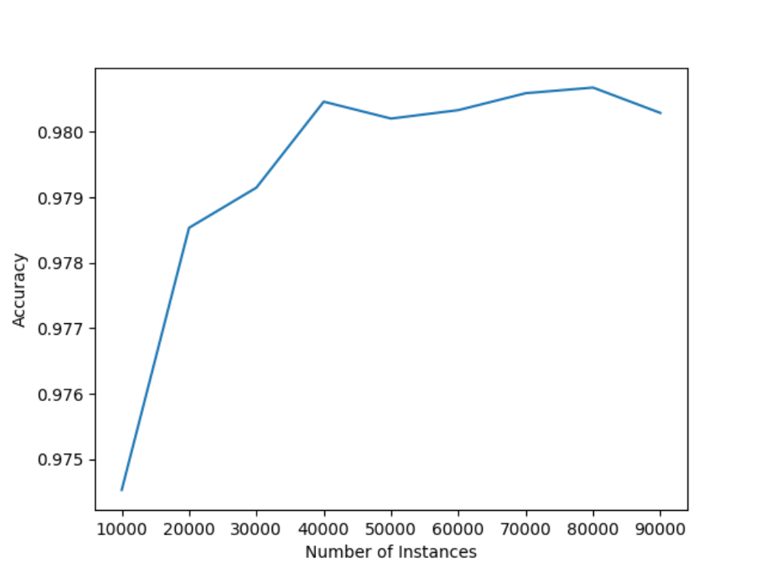
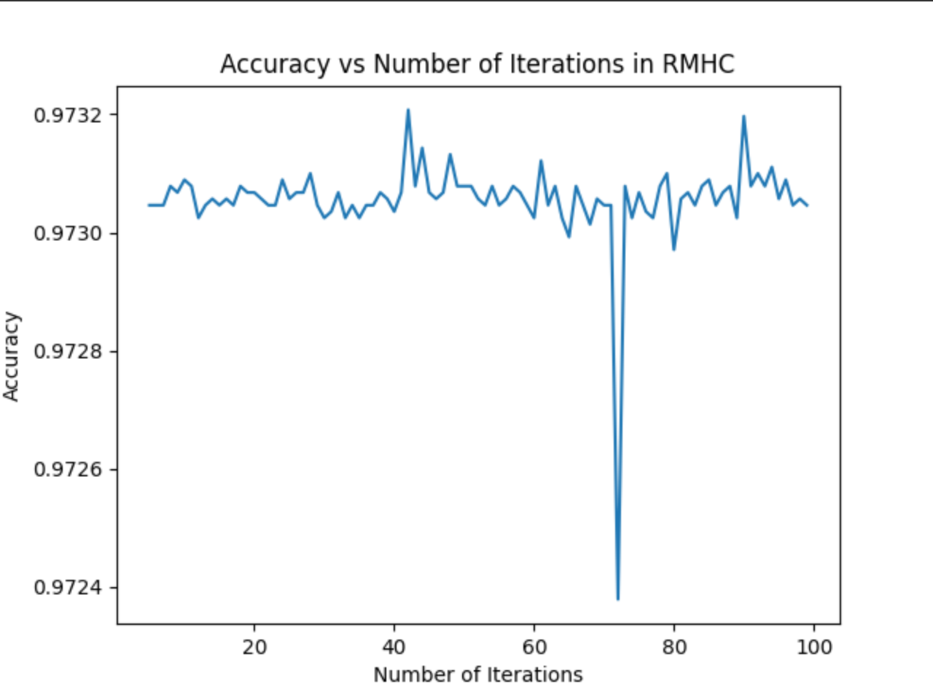
Effects of M and N on KNN Accuracy
Changing N Value
Changing M Value

Slide 18
Improved KNN Model
Hyperplane generation and region assignment
Training Set
RMHC
Training Subset
New Training Set

Slide 19
Improved KNN Model
Regional KNN Model
Is the test point in a region with train points?
Yes
Test point
Global KNN Model
No
All train points
Global KNN Model
If a region has less than K training points, voting is done immediately.
For every Region
Points in Region
Regional KNN Model

Slide 20
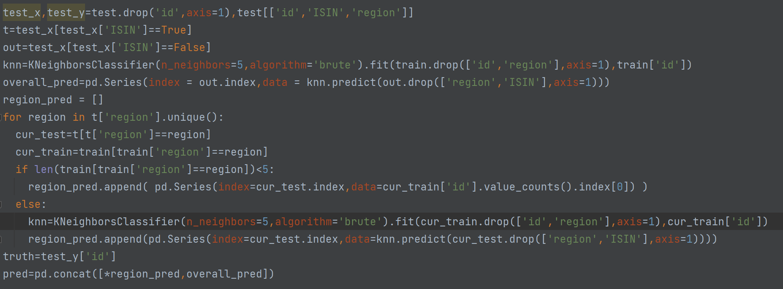

Slide 21
Existing Alternatives

Slide 22
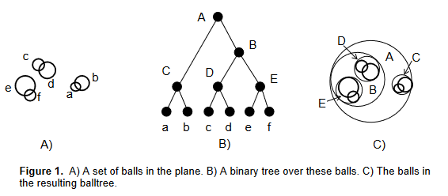
Ball Trees
A ball tree is a complete binary tree in which a ball is associated with each node in such a way that an interior node’s ball is the smallest which contains the balls of its children.
Notes:
Image Credit Omohundro(1989)

Slide 23
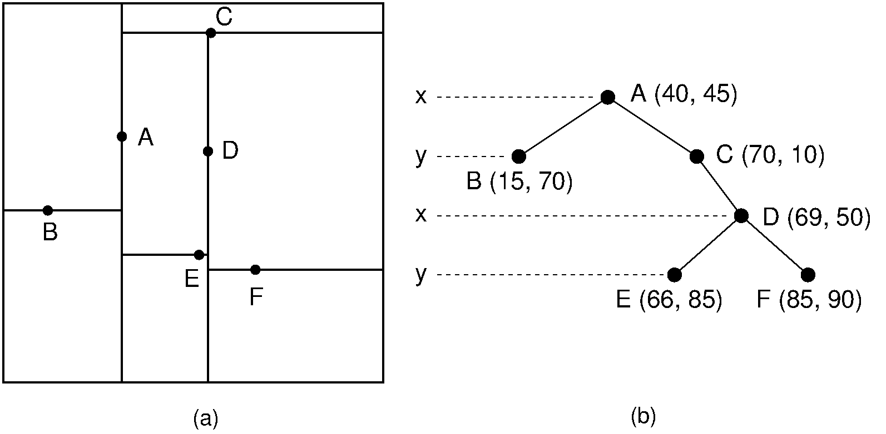
KD Trees
KD-trees pick a random dimension then split the data into blocks divided by the median value, each of these blocks are children of the original node.
Notes:
Image Credit https://opendsa-server.cs.vt.edu/ODSA/Books/Everything/html/KDtree.html

Slide 24
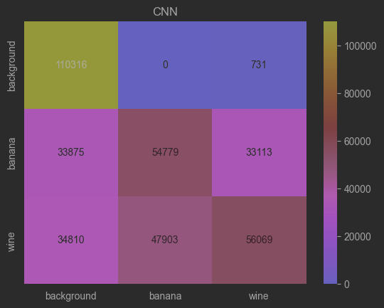
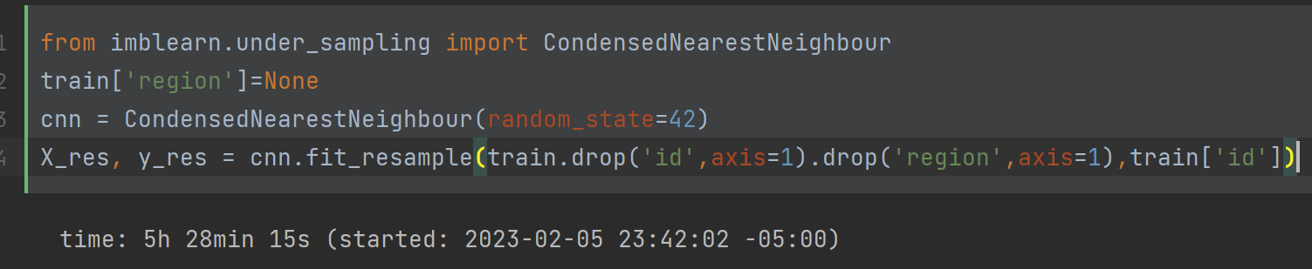
CNN
reduces data size by generating a subset of the training data and removing points that do not affect the classification of points in the training data. This approach will retain ‘noisy’ data and amplify its effects thus reducing accuracy but improving speed.
Took 5 hours to run the data reduction method
Accuracy of 0.6157640985728808
1 minute to run KNN

Slide 25
Results

Slide 26
Metrics
Runtime and Accuracy
Since we want to ensure that a drop in runtime does not equate to a large drop in performance, so we will use accuracy as a standard metric. Since the dataset is well balanced, accuracy is a good overall standard measure of performance.
Runtime measured on the same machine with the same random state to ensure fair comparisons

Slide 27
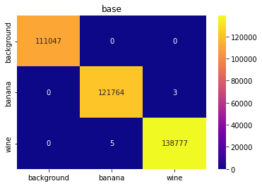
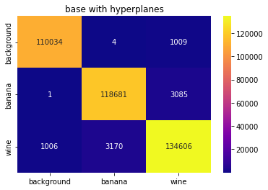

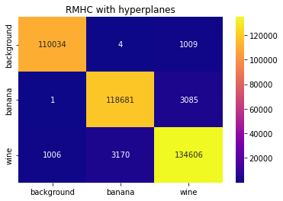

Slide 28
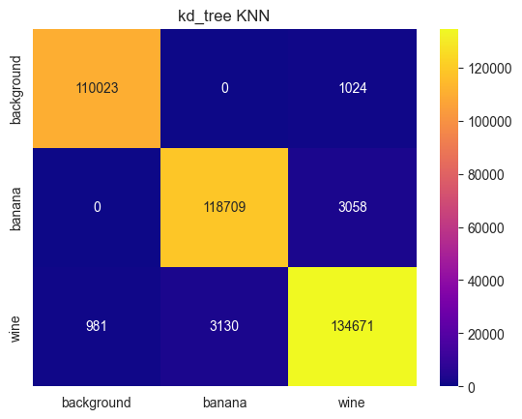
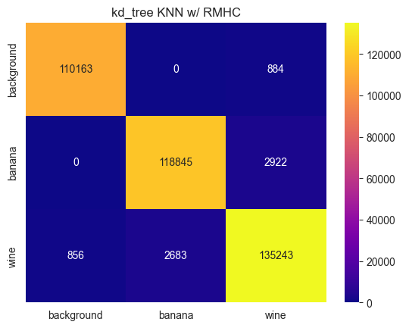

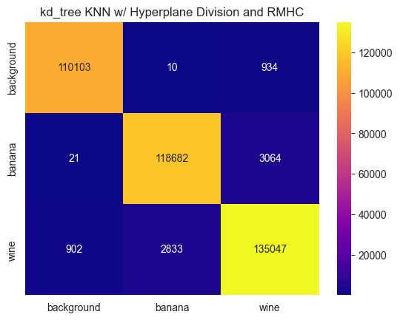

Slide 29





Slide 30
Metrics w/ KNN
Algorithm | Time to Run (seconds) | Accuracy
KNN | 267 | 0.9999784712429628
KNN on Reduced Dataset through RMHC | 118 (+47.5) | 0.9998735185524064
KNN with Hyperplane Division | 38.1 (+205) | 0.9777311919396333
KNN with Reduced Dataset through RMHC and Hyperplane Division | 19.1 (+143.5) | 0.9792059117966824

Slide 31
Metrics w/ kd_KNN
Algorithm | Time(Seconds) | Accuracy
Kd_tree KNN | 7.15 | 0.9779518616992648
Kd_tree KNN on Reduced Dataset through RMHC | 5.66 (+47.5) | 0.9802339099452093
Kd_tree KNN with Hyperplane Division | 10.3 (+148) | 0.9776558412900032
Kd_tree KNN with Reduced Dataset through RMHC and Hyperplane Division | 6.7 (+145.5) | 0.9791063412953853

Slide 32
Metrics w/ ball_KNN
Algorithm | Time to Run (seconds) | Accuracy
Ball_tree KNN | 288 | 0.977981463740191
Ball_tree KNN on Reduced Dataset through RMHC | 222 (+47.5) | 0.9802096900935424
Ball_tree KNN with Hyperplane Division | 14 (+220) | 0.9772333394331478
Ball_tree KNN with Reduced Dataset through RMHC and Hyperplane Division | 7.52 (+150.5) | 0.9790982680114964

Slide 33
Algorithm | Run Time(seconds) | Preprocessing Time(seconds) | Total | Accuracy
KNN | 267 | 0 | 267 | 0.9999784712
KNN on Reduced Dataset through RMHC | 118 | 47.5 | 165.5 | 0.9998735186
KNN with Hyperplane Division | 38.1 | 205 | 243.1 | 0.9777311919
KNN with Reduced Dataset through RMHC and Hyperplane Division | 19.1 | 143.5 | 162.6 | 0.9792059118
Kd_tree KNN | 7.15 | 0 | 7.15 | 0.9779518617
Kd_tree KNN on Reduced Dataset through RMHC | 5.66 | 47.5 | 53.16 | 0.9802339099
Kd_tree KNN with Hyperplane Division | 10.3 | 148 | 158.3 | 0.9776558413
Kd_tree KNN with Reduced Dataset through RMHC and Hyperplane Division | 6.7 | 145.5 | 152.2 | 0.9791063413
Ball_tree KNN | 288 | 0 | 288 | 0.9779814637
Ball_tree KNN on Reduced Dataset through RMHC | 222 | 47.5 | 269.5 | 0.9802096901
Ball_tree KNN with Hyperplane Division | 14 | 220 | 234 | 0.9772333394
Ball_tree KNN with Reduced Dataset through RMHC and Hyperplane Division | 7.52 | 150.5 | 158.02 | 0.979098268
CNN | 60 | 19695 | 19755 | 0.6157640986
Notes:
https://docs.google.com/spreadsheets/d/18qvQkfSrFbvyKfMbuZ0CEGSVx0ybysDJ8riMgiP3ZsI/edit?usp=sharing

Slide 34
Conclusion
Overall, our model worked well with a significant time decrease and a very slight drop in accuracy
Kd_trees is the best way to supplement the algorithm, and works very well with RMHC and by itself
Very dependent on random occurrences, so future work needs to be done on improving dependability and reliability by reducing randomness
Need to find better ways to find m, n, and k values.

Slide 35
References
[1] Si, L., Yu, J., Wu, W., Ma, J., Wu, Q., & Li, S. (2017). RMHC-MR: Instance selection by random mutation hill climbing algorithm with MapReduce in big data. Procedia computer science, 111, 252-259.
[2] Wang, H., Xu, P., & Zhao, J. (2022). Improved KNN algorithms of spherical regions based on clustering and region division. Alexandria Engineering Journal, 61(5), 3571-3585.
[3]Yong, Z., Youwen, L., & Shixiong, X. (2009). An improved KNN text classification algorithm based on clustering. Journal of computers, 4(3), 230-237.
[4]Jing, Y., Gou, H., & Zhu, Y. (2013, June). An improved density-based method for reducing training data in KNN. In 2013 International Conference on Computational and Information Sciences (pp. 972-975). IEEE.
[5]Wang, H., Xu, P., & Zhao, J. (2021). Improved KNN Algorithm Based on Preprocessing of Center in Smart Cities. Complexity, 2021.
[6] Dua, D. and Graff, C. (2019). UCI Machine Learning Repository [http://archive.ics.uci.edu/ml/datasets/gas+sensors+for+home+activity+monitoring]. Irvine, CA: University of California, School of Information and Computer Science.
[7] Alasadi, S. A., & Bhaya, W. S. (2017). Review of data preprocessing techniques in data mining. Journal of Engineering and Applied Sciences, 12(16), 4102-4107.
[8] Wilson, D.R., Martinez, T.R. Reduction Techniques for Instance-Based Learning Algorithms. Machine Learning 38, 257–286 (2000). https://doi.org/10.1023/A:1007626913721
[9] Omohundro, S. M. (1989). Five balltree construction algorithms (pp. 1-22). Berkeley: International Computer Science Institute.
[10] Bentley, J. L. (1975). Multidimensional binary search trees used for associative searching. Communications of the ACM, 18(9), 509-517.

Slide 36
Libraries
scikit-learn
numpy
pandas
math
matplotlib
seaborn
ipython-autotime
timeit

Slide 37
Questions?

